Slide 1
Web Search Engine
Instructor : Dr. Luis Rueda
Adarsh Sai Gupta | 105181433

Slide 2
Outline
Introduction
Block Diagram
Techniques used
Additional Features
Demo
Conclusion
References

Slide 3

Introduction
A web search engine is a software designed to carry out web search in a systematic way for particular information specified in a textual web search query.
We have used several algorithms that are explained in the lectures for building our search engine.

Slide 4
Block Diagram
Start
User Input
Implement spell check and retrieve synonyms
Web Crawler
NO
Extract existing pages
YES
Extract HTML pages from the provided URL
Ranking the pages based on word frequency
Convert HTML pages to text files
Extracting useful information through Pattern finder using Java Regex
End

Slide 5
Techniques Used
Web Crawler :
Starts with a URL that is provided and extracts all the hyperlinks present in there. It then searches for the input string provided by user in the list of hyperlinks. The retrieved web pages are stored as html in a folder using Jsoup.
Ranking based on word frequency :
We have implemented hash map for paging the webpages based on the word frequency and ranking these webpages using the Merge sort function in the Collections framework.

Slide 6
Techniques Used (continued)
HTML to text file conversion:
Using Text Writer class Html pages are converted to Text pages and stored in a folder.
Pattern finder using Java Regex:
Extracting useful information such as phone numbers and email addresses from the files using regular expressions.
Mobile Number Pattern = “[\\(]?\\d{3}[\\)]?([-.]?)\\s*\\d{3}\\1\\s*\\d{4}"
Email Pattern = "([a-zA-Z0-9\\+\\.\\_\\%\\-\\+]{1,256}\\@[a-zA-Z0-9][a-zA- Z0-9\\-]{0,64}(\\.[a-zA-Z0-9][a-zA-Z0-9\\-]{0,25})+)"

Slide 7
Techniques Used (continued)
Search Operation : Boyer Moore
An input string is searched in all the html files.

Slide 8
Techniques Used (continued)
Edit distance
This is implemented for word suggestion, that is when the user inputs a word it provides the most relevant word.
Finding synonyms
Designing UI using Java Swing
Additional Features

Slide 9
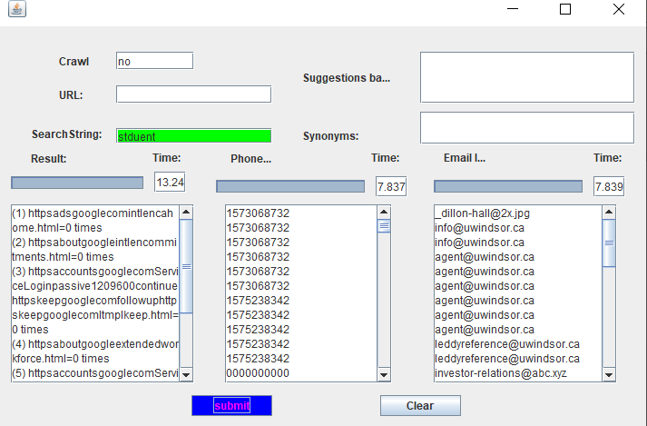
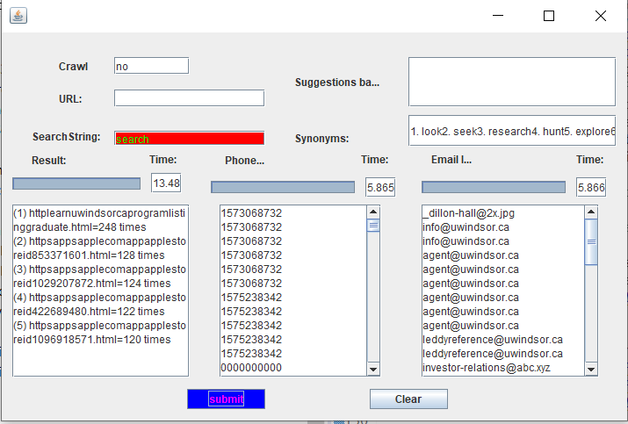
Spelling Correct!
Spell Checker
Incorrect Spelling!
Auto-Corrected Word

Slide 10
DEMO

Slide 11
Conclusion
Through our web search engine, user can retrieve optimal search results as it uses efficient algorithms.
By using the concepts that are explained in class, we not only developed a search engine but also we had a hands on experience on how to use these algorithms in real time application.

Slide 12
References
Synonyms API
https://www.datamuse.com/api/
Boyer Moore
https://en.wikipedia.org/wiki/Boyer%E2%80%93Moore_string-search_algorithm
Camtasia Tool
https://feedback.techsmith.com/techsmith/topics/adding_url_links_to_camtasia_videos
Edit Distance Algorithm
https://www.geeksforgeeks.org/edit-distance-dp-5/

Slide 13


